Slide 1
Create Test Plan
Group Members:

Slide 2
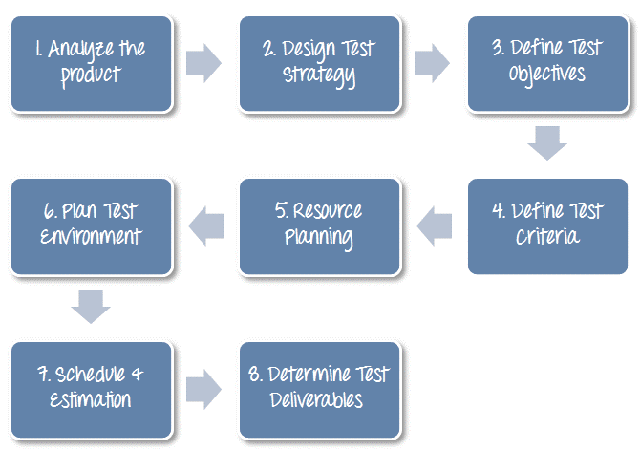
Test Plan Process
Software Testing

Slide 3
Step 1) Analyze the product
Who will use the website?
What is it used for?
How will it work?
What are software/ hardware the product uses?
  User manual
  Documents
  Forum ?
Software Testing

Slide 4
Step 2) Develop Test Strategy
Step 2.1) Define Scope of Testing
Step 2.2) Identify Testing Type
Step 2.3) Document Risk & Issues
Step 2.4) Create Test Logistics
Software Testing

Slide 5
Step 3) Define Test Objective
List all the software features (functionality, performance, GUI…) which may need to test.
Define the target or the goal of the test based on above features
Software Testing

Slide 6
Step 4) Define Test Criteria
Suspension Criteria
Exit Criteria
Software Testing

Slide 7
Step 5) Resource Planning
Human Resources
  Roles
System Resources
Software Testing

Slide 8
Step 6) Plan Test Environment
How to setup
Software Testing

Slide 9
Step 7) Schedule & Estimation
Task estimation
Project schedule
  Gantt chart
Task | Members | Estimate effort
Software Testing

Slide 10
Step 8) Test Deliverables
Test deliverables are provided before testing phase.
  Test plans document.
  Test cases documents
  Test Design specifications.
Test deliverables are provided during the testing
  Test Scripts
  Simulators.
  Test Data
  Test Traceability Matrix
  Error logs and execution logs.
Test deliverables are provided after the testing cycles is over.
  Test Results/reports
  Defect Report
  Installation/ Test procedures guidelines
  Release notes
Software Testing

